Slide 1
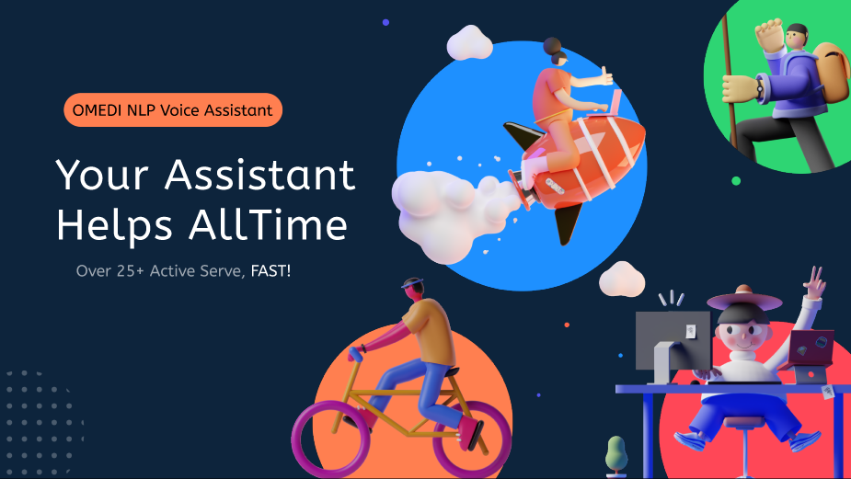

Slide 2
OMEDI- NLP
Voice Assistant
Everything is more simple with voice control.

Slide 3
Contents
Overview
Requirement inference
Fill the cavities
Crossing the threshold and touching to user
OMEDI NLP Voice Assistant
Osman Melih Tolunay
Dilan Kaya
Umut Şentürk
Mustafa Körükmez

Slide 4
Overview
What is the voice assistant?
HEY!
Hello dear Alex how can I help you?

Slide 5
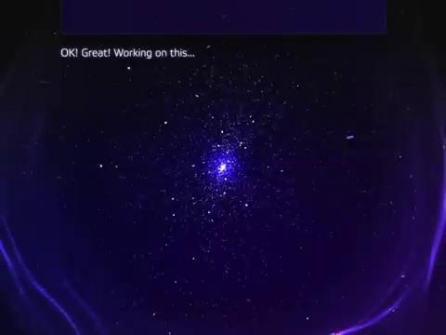

Slide 6
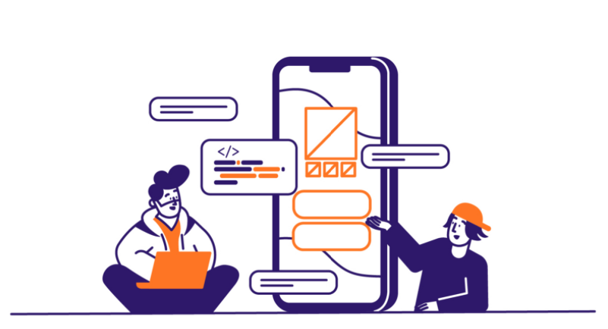

Requirement inference
Jacob: Young businessman he needs to get few staff but he has not enough money for it.

Slide 7


Requirement inference
Wang: She is a student and she wants to improve herself about some sciences and cooking. But she just has a computer

Slide 8

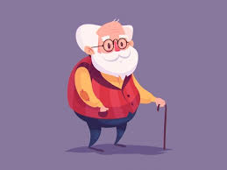
Requirement inference

Slide 9



What is our domain?
Who needs a helper?
Who needs a friend?
Who needs a game friend?
Who needs an online teacher?

Slide 10
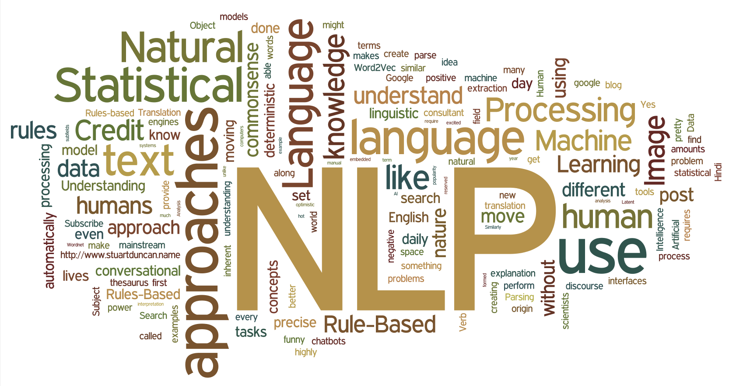

Fill the cavities
Domain needs to find always active friend. Domain needs to improve, learn somethin, read something and manage something more and more...

Slide 11


Fill the cavities
What product team should do?
Security Low Price Usability Accessibility

Slide 12

Crossing the threshold and touching to user
Touch the users
Careful and reliable steps
Logical flow plans
Sustainable architecture
And most importantly a beautiful design

Slide 13

Thanks for watching
Everything is better with voice control.

